Slide 1
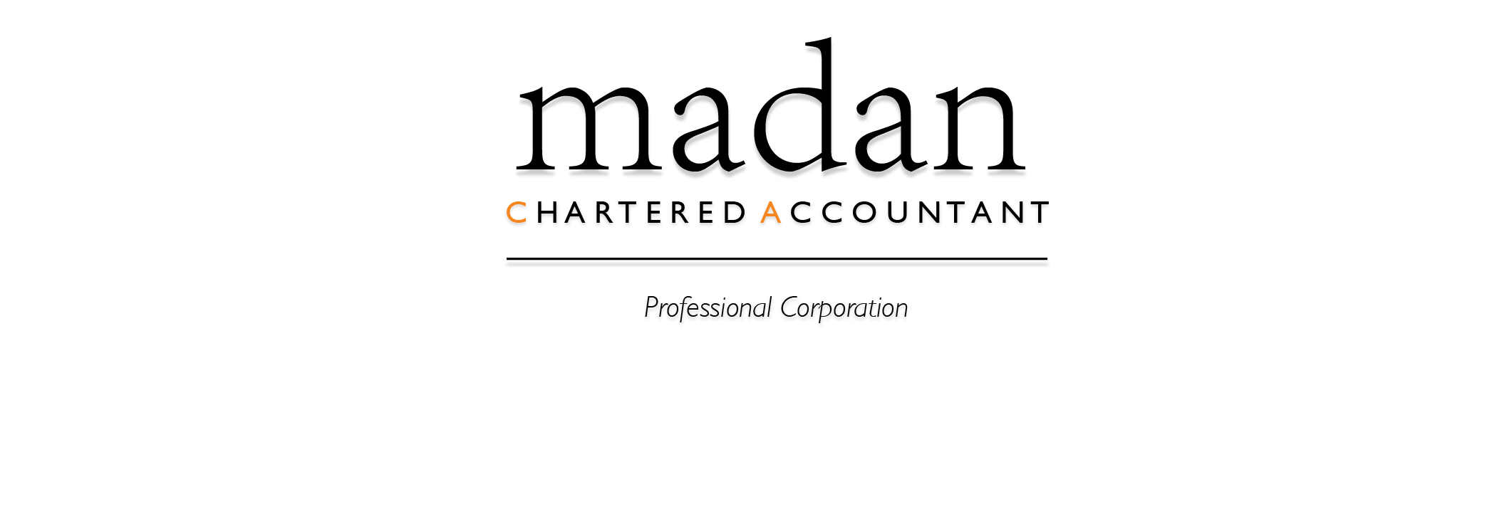
Tax Tips for Real Estate
Investors
With Allan Madan

Slide 2

Capital Gains Tax
Pay capital gains tax on the sale of your investment property
Only half the profit is taxable
WWW.MADANCA.COM
905 268 0150

Slide 3

Profit on Sale of Real Estate
Investments
Net sales proceeds minus the cost = Profit (gain)
Net sales proceeds = selling price & legal fees paid to lawyer & commission to realtor
Cost = Original Purchase Price + improvements
WWW.MADANCA.COM
905 268 0150

Slide 4

Improvements
Improvements increase cost of your property & reduce tax
Extend the life of your real estate investment
WWW.MADANCA.COM
905 268 0150

Slide 5
Capital Cost Allowance
Selling a property? Factor in depreciation (Capital Cost Allowance)
Depreciation on your property is tax deductible
Capital cost allowance claimed must be included in your taxable income known as recapture
WWW.MADANCA.COM
905 268 0150

Slide 6
Sole Proprietor Taxes
Sole proprietor = Sole owner of property
Sole proprietor will pay capital gains tax on real estate sale of rental property
Sole Proprietor does not have limited liability protection (you could lose your home/car/savings /etc. )
WWW.MADANCA.COM
905 268 0150

Slide 7
Income Splitting with Partner
By purchasing the house jointly with your spouse. You and your spouse can split the profits from the rents on a 50/50 basis.
This is much better tax strategy compared to buying the house solely in your name and including all of the income from the house on your tax return.
Spousal loan – 1%
WWW.MADANCA.COM
905 268 0150

Slide 8
Taxes for Corporations on
Real Estate Canada
Buy real estate through a corporation to have limited liability.
Personal assets remain unharmed if property suffers a loss
Double taxation may occur
Sell a property for profit -> Pay capital gains tax
Income splitting with shareholders
WWW.MADANCA.COM
905 268 0150

Slide 9
Taxes for Corporations on
Real Estate Canada
After-tax profits distributed to shareholders in the form of dividends are taxed personally.
Dividend tax credit to help reduce taxes payable
High income tax – combined federal and provincial rate (roughly 50%)
Almost the same tax rate for individuals who are in the highest marginal bracket.
  Tax savings do not result by holding real estate in a corporation
  Tax on flips = 15% corporate tax ; consider bare trust
WWW.MADANCA.COM
905 268 0150

Slide 10
Tax Write offs
For rental properties in Canada, the most common expenses that are deductible are:
  Capital Cost Allowance
  Repairs and maintenance
  Interest
  Property taxes
  Utilities
  Capital improvements
  Management fees paid to a property manager
WWW.MADANCA.COM
905 268 0150

Slide 11
Change in Use of Property
1) Convert all/part of principal residence to a rental or business operation
2) Change rental or business operation to principal residence
If you generate a profit (fair market value > adjusted cost base)
= taxable gain must be reported on personal tax return
WWW.MADANCA.COM
905 268 0150

Slide 12
Rent out a Part of your Home
Most cases: Renting a house you are living in? Capital gains realized will be tax exempt
Principal Residence is not considered to have changed its use (to a rental property) if:
rental/business property is small compared to personal residence part
There is no structural changes to the property making or suitable for business or rental purpose
No CCA has been deducted on the business or rental part
WWW.MADANCA.COM
905 268 0150

Slide 13
If these conditions are not met then you must:
Split the selling price between rental part and principal residence part.
Report any capital gains on the part you used for rental purposes – no gains will be reported for principal residence portion.
WWW.MADANCA.COM
905 268 0150

Slide 14
Benefits of the 3 Tier Structure for Real Estate Investor
With Allan Madan
WWW.MADANCA.COM
905 268 0150

Slide 15

Three Tier Structure
Is designed for and used by real estate investors. It consists of three corporations:
  A management corporation
  A Real Estate company
  Holding corporation
WWW.MADANCA.COM
905 268 0150

Slide 16
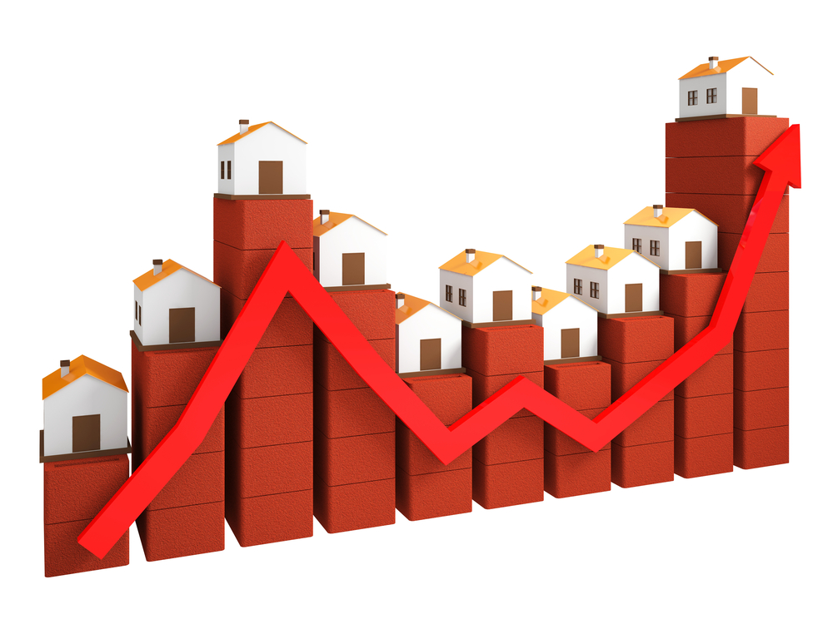
A Management Corporation
The management company provides property management services to the real estate company in turn for a fee.
WWW.MADANCA.COM
905 268 0150

Slide 17
Real Estate Company
The real estate company owns land and buildings.
Real estate company distributes cash dividends from its rental profits to the holding company on a periodic basis.
WWW.MADANCA.COM
905 268 0150

Slide 18

Holding Corporation
The holding company behaves like a piggy bank and owns 100% of the shares of the real estate company
WWW.MADANCA.COM
905 268 0150

Slide 19
3 Major Benefits
Management company pays a low rate of tax of only 15% on business profits.
Real estate company has reduced risks for lawsuits because it’s not performing any property management services.
Holding company protects cash retained earnings from creditors.
WWW.MADANCA.COM
905 268 0150

Slide 20
Final Tip
If you are a serious real estate investor, use the three tier structure to reduce legal risk, protect cash, and lower your tax bill.
WWW.MADANCA.COM
905 268 0150

Slide 21
Canadians Selling a US Property
With Allan Madan
WWW.MADANCA.COM
905 268 0150

Slide 22
Withholding Tax
Sale of your US property requires the purchaser to withhold 15% of total proceeds
Avoid this by applying for a withholding tax certificate from the IRS
In order to apply – File Form 8288 – B before closing date
Tax identification number is required.
Complete from W-7 if you do not have tax ID number
WWW.MADANCA.COM
905 268 0150

Slide 23
File your US tax Return
After selling your US property, file a non-resident US income tax return (Form 1040NR) and report capital gain
Capital gains tax from the sale of your property is calculated based on your tax bracket
WWW.MADANCA.COM
905 268 0150

Slide 24
Long Term Capital Gains
Long Term Capital Gains – Sale of property owned over a year
Rates for capital gains
-Tip : Withholding tax can be applied as an installment payment credit on your return
Tax Rate | Tax Bracket
0% | 10% - 15%
15% | 15% - 20%
20% | 39.6%
WWW.MADANCA.COM
905 268 0150

Slide 25
Canadian Income Tax
Pay Canadian income tax on your world wide income
Capital gain from US property must be expressed in Canadian Dollars – (exchange rate at time of sale)
Capital gain – varies depending on dollar rate
WWW.MADANCA.COM
905 268 0150

Slide 26
Capital Gains
Canada | US
50% taxable | 100% taxable
US
First $37,650 USD is 0% taxable, the rest is 15% taxable if you are a single filer for long term capital gains.
WWW.MADANCA.COM
905 268 0150

Slide 27
Reduce your Canadian Income Tax
Claim a foreign tax credit (FTC) to prevent double taxation
Tax Payable | Foreign Tax Credit | = Net Tax Payable
WWW.MADANCA.COM
905 268 0150

Slide 28
Rent your US property
Your tenant will withhold 30% of total rent and submit it to the IRS
WWW.MADANCA.COM
905 268 0150

Slide 29
Avoid Withholding Tax
Elect income to be treated as income generated by a US business to avoid withholding tax
Deduct expenses related to rental property
Complete the election – report rental income on US income tax return from 1040NR
Claim US rental income on Canadian tax return + a foreign tax credit
WWW.MADANCA.COM
905 268 0150

Slide 30
Canadians Buying US Real Estate
With Allan Madan
WWW.MADANCA.COM
905 268 0150

Slide 31
Direct Ownership of the Property by an Individual
No liability protection
Different states have different direct ownership alternatives
Do not recommend owning a US property in your name
WWW.MADANCA.COM
905 268 0150

Slide 32
Ownership through a Canadian Corporation
Double taxation problem for investors in the US
Owning US real estate, a Canadian corporation will be deemed as doing business in the US and must file form 1120-F to the IRS.
Pay tax on your corporation
Pay tax on dividends paid to shareholders
WWW.MADANCA.COM
905 268 0150

Slide 33
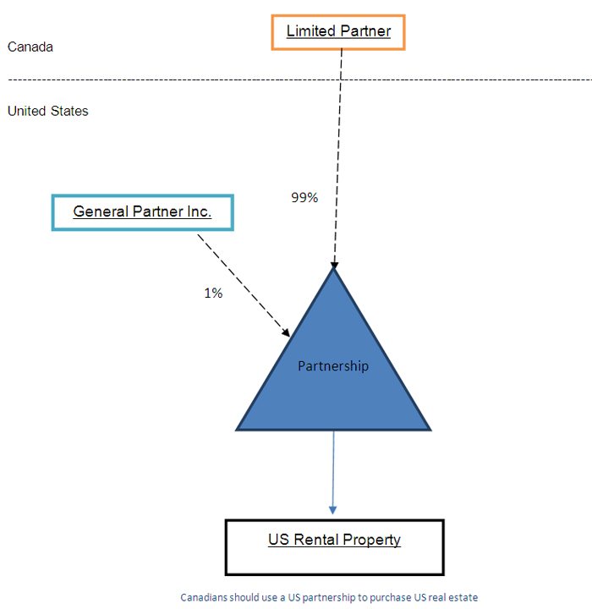
Establish US limited Liability Partnership
Provides asset protection and legal liability protection
Investor avoids double taxation
WWW.MADANCA.COM
905 268 0150

Slide 34
Real Estate Tax
Estate tax in more detail
Canada imposes tax on the accrued gain of a deceased taxpayer at time of death,
U.S. imposes tax on net asset of the taxpayer at the time of death
For Canadians that are not US residents, estate tax applies on the value of their U.S. assets if the FMV of their worldwide assets exceed $5.34Million (2014)
WWW.MADANCA.COM
905 268 0150

Slide 35
Estate Tax
Estate tax – Unified credit
The U.S. allows Canadian taxpayer to reduce their U.S. estate tax liability by the following amount:
$2,081,800 x | FMV of U.S Asset
 | FMV of Worldwide Asset
WWW.MADANCA.COM
905 268 0150

Slide 36
Double Tax Problem
S Corporations
LLC
Flow-through for US
Corporation for Canada
WWW.MADANCA.COM
905 268 0150

Slide 37
Tax Issue for Non-Resident Investors
Tax Account Number
  Mandatory to obtain a tax account number so the CRA can track your tax filings
Withholding Tax
  Withholding tax applies at a rate of 25% on the rents that you collect in Canada
NR6 Form
  This form reduces the withholding tax
WWW.MADANCA.COM
905 268 0150

Slide 38
Tax Issue for Non-Resident Investors
NR4 Slip
  This slip reports the gross rents you collected and the total withholding tax you remitted to the CRA.
  You have to collect this form no later than March 31st of the following year or you will face a penalty
WWW.MADANCA.COM
905 268 0150

Slide 39
Tax Issue for Non-Resident Investors
Annual Tax Returns
  Annual tax returns must be filed
  Section 216 tax return is due by June 30th of the following year
WWW.MADANCA.COM
905 268 0150

Slide 40
Disclaimer
The information provided in this presentation is intended to provide general information. The information does not take into account your personal situation and is not intended to be used without consultation from accounting and financial professionals.
Allan Madan and Madan Chartered Accountant will not be held liable for any problems that arise from the usage of the information provided on this presentation.
WWW.MADANCA.COM
905 268 0150

